Slide 1
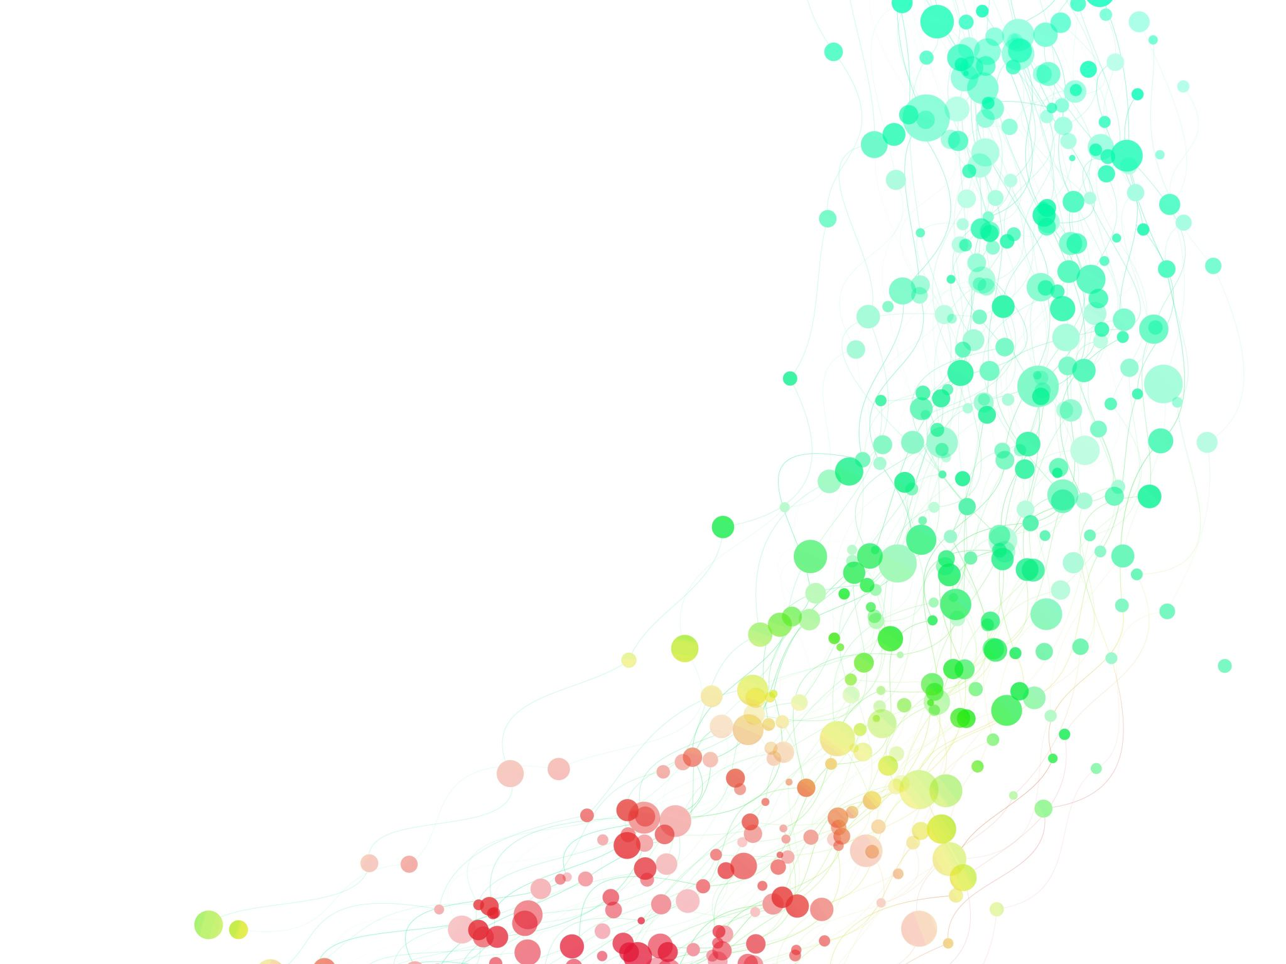
Heart Failure Patient Risk of Death Profile
Capstone II: Unsupervised Learning
By: Rakim Reid
5/12/2023

Slide 2

About Heart Failure
The purpose of this project is to create groupings of heart failure patients of sudden death. This will enable the determination those most at-risk of sudden death and, if desired, predict which group patients belong.

Slide 3
What is heart failure?
Well, according to the Mayo Clinic:
“Heart failure occurs when the heart muscle doesn't pump blood as well as it should. When this happens, blood often backs up and fluid can build up in the lungs, causing shortness of breath.
Certain heart conditions gradually leave the heart too weak or stiff to fill and pump blood properly. These conditions include narrowed arteries in the heart and high blood pressure.

Slide 4

Data Source
Tanvir Ahmad, Assia Munir, Sajjad Haider Bhatti, Muhammad Aftab, and Muhammad Ali Raza: "Survival analysis of heart failure patients: a case study". PLoS ONE 12(7), 0181001 (2017).
Features used were:
Age, creatinine phosphokinase, platelets, serumcreatinine, and serum sodium.

Slide 5
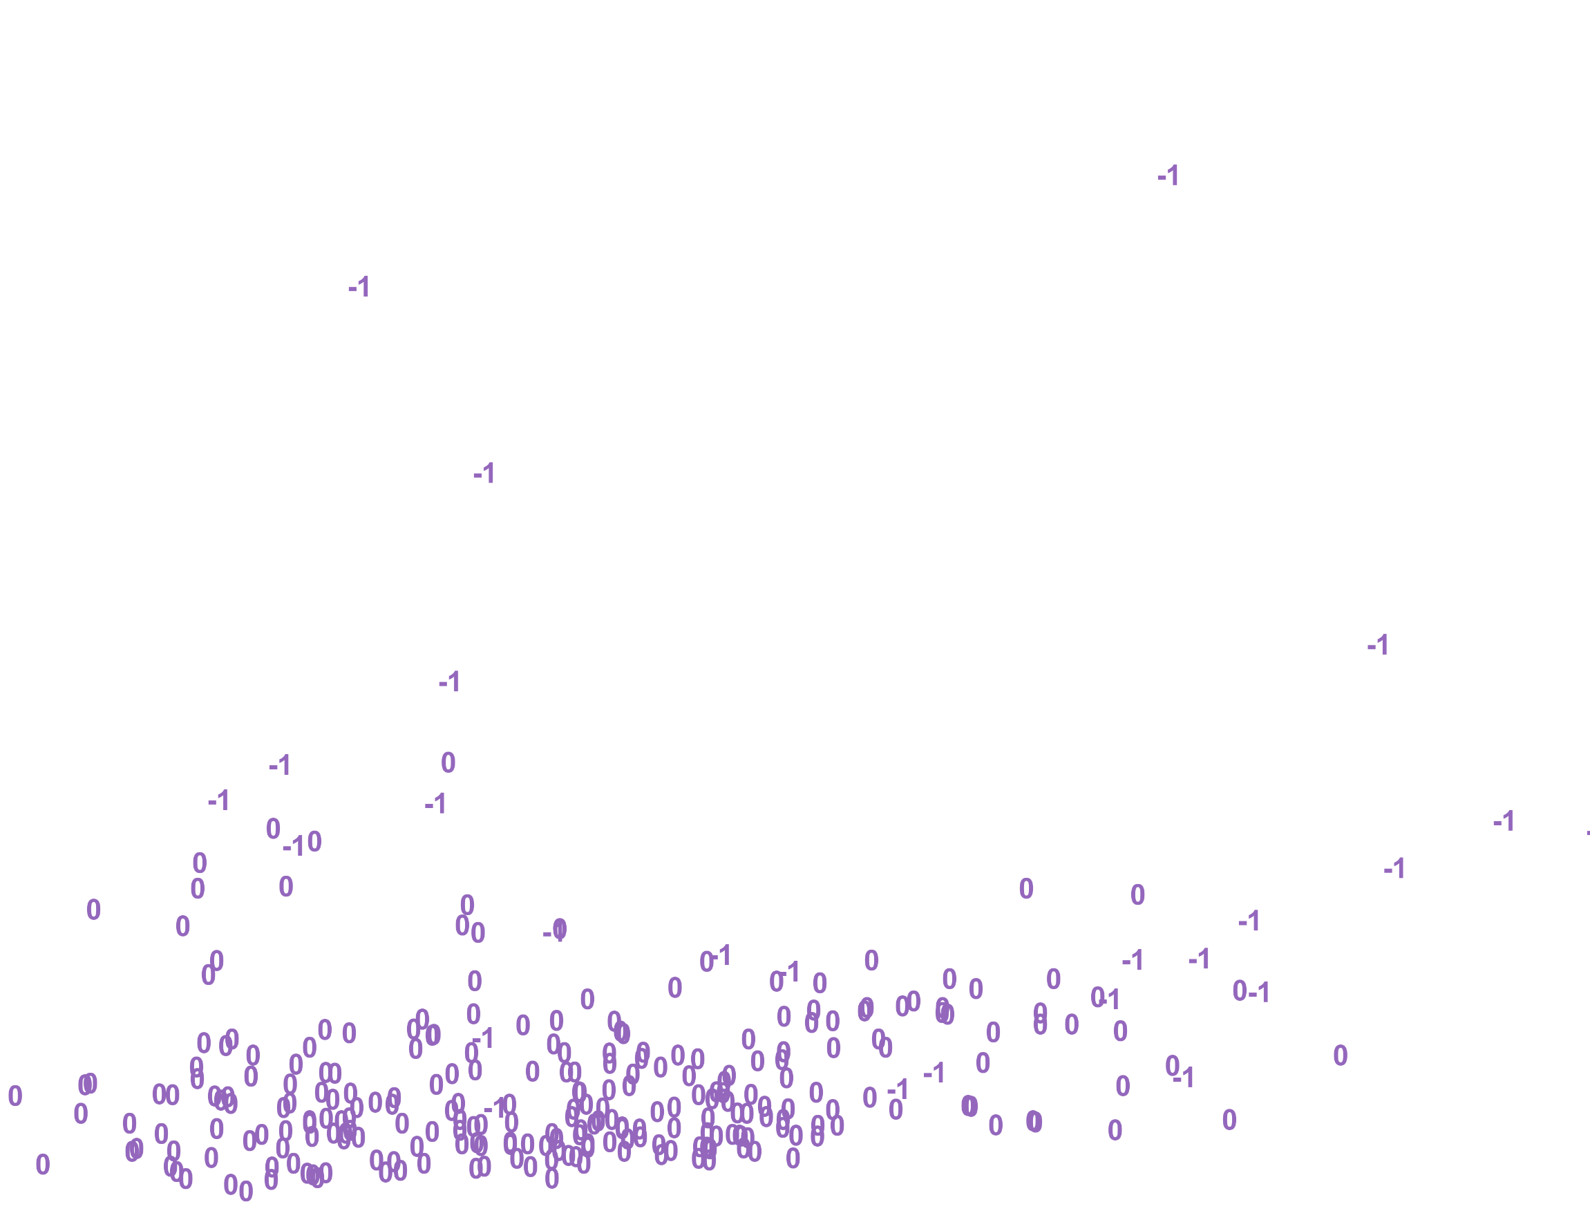
Chosen Model
DBSCAN with PCA
2 clusters
Minimal misclassifications

Slide 6
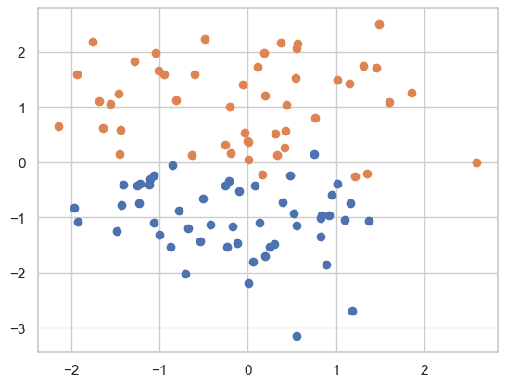
Possible Alternate Model
Spectral Clustering
2 clusters
No to minimal misclassifications

Slide 7
The DBSCAN w/ PCA, two clusters, and Euclidean distance performed the best – for the most appropriate model. There might be merit to pursuing spectral clustering. BIRCH clustering misclassified one point while spectral clustering properly classified all the points. This capstone illustrates the viability of using clustering methods to segment patients who may be at risk of heart failure. Other data transformations like UMAP may be useful to improve results.
Conclusion

